Slide 1

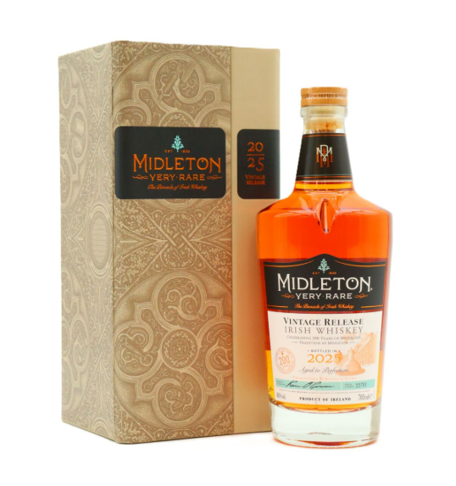
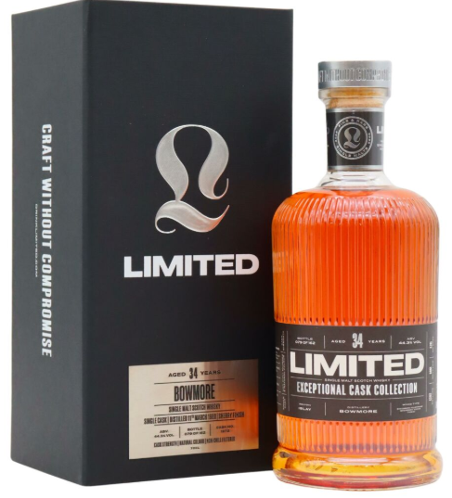
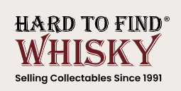
The Whiskey Code
Behind the label do you believe in quantity or quality

Slide 2
About me
I have recently completed my Bachelor of Computer Applications (BCA) from Parul University, Vadodara.
I have prior experience in Python and data manipulation, so I developed a strong interest in the field of Data Science.
Motivated by this passion, I have decided to pursue Data Science as my career path.
Here are links to my GitHub and LinkedIn profiles.
https://www.linkedin.com/in/shubham-parmar-12164024a/
https://github.com/shubham132004

Slide 3
Problem Statement :
Due to lack of structured data in the collectible whisky market leads to uncertain decisions.
This project uses data analysis to uncover insights into pricing, quality, and trends — enabling smarter investments and sales.
Objective :
The objective of this project is to perform an exploratory data analysis (EDA) on rare and collectible whisky data to identify patterns, trends, etc.
By analyzing key attributes such as brand, type, alcohol content (ABV%), and pricing, the project aims to generate actionable insights that can support better decision-making for investors, and retailers.

Slide 4
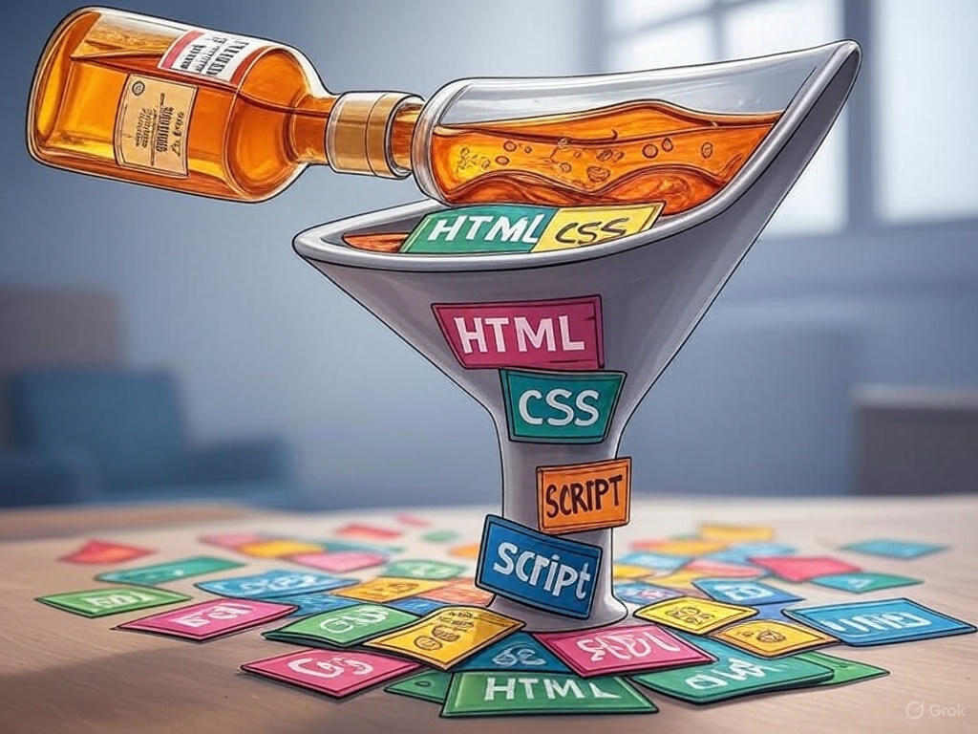
Web Scrapping - Process
Website : https://www.htfw.com/
(Hard To Find Whiskey)
Steps Followed While Scrapping :
Inspecting Structure : Right click on your mouse and inspect the website to get various tags.
Column Identification : Selecting appropriate tags for extracting various categories like Brand , Price , Type , etc
Libraries used while scrapping :
- requests – To send http request and get response from server
- BeautifulSoup – For parsing the html content
Other Libraries :
- Pandas – For data manipulation .
- Matplotlib and Seaborn – For visualizing the data

Slide 5
SUMMARY
Numerical Columns
Price_Rupees : Whiskeys Prices in INR
ABV_Percent : Shows how much percentage of alcohol whiskey contains
Centi_liter : Shows number of Centiliter each whiskey contains
Mili_liter : Shows number of Mililiter each whiskey contains
Categorical Columns
Brand : Contains all the whiskey brand names
Varieties : Contains all the varieties of whiskey
Type : Contain different types of whiskey names
Year : Shows how old the whiskeys are
ABV_Category : This shows how much alcoholic the whiskeys are and this are divided in Low , Medium and High .

Slide 6
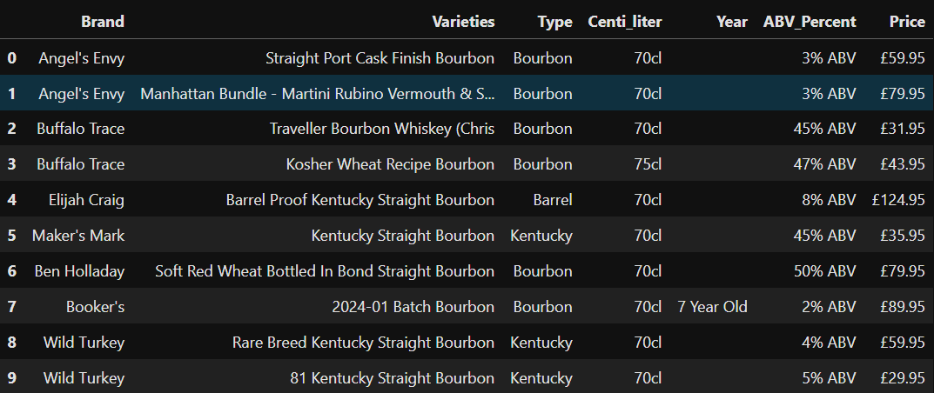
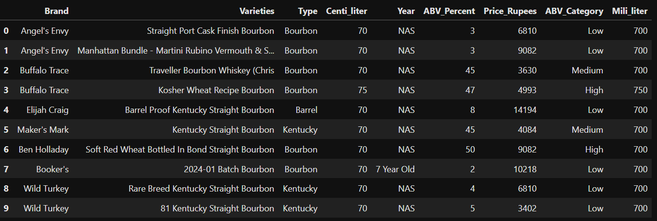
Data Frame After Scrapping The Wesbite
Data Frame After Cleaning The Data

Slide 7
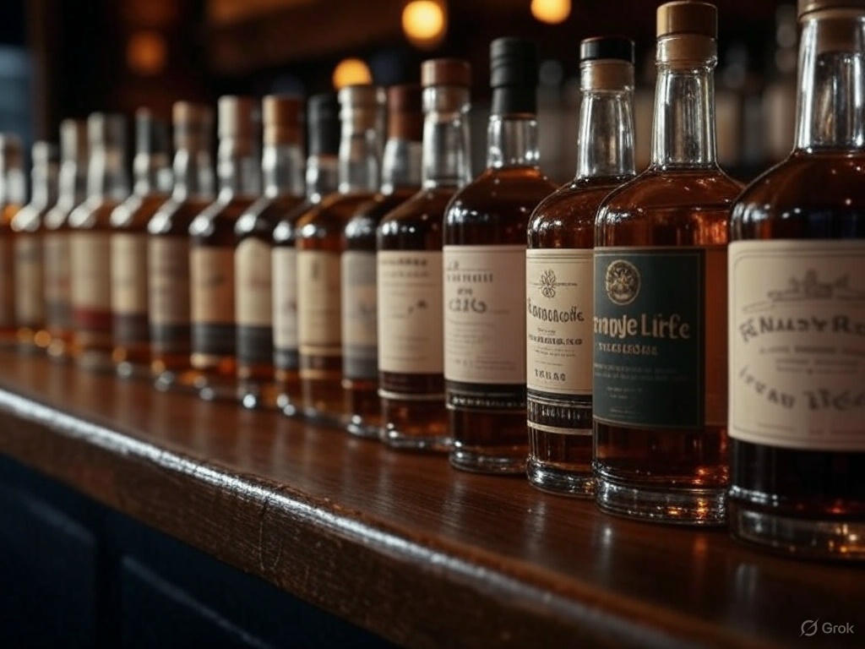
Whiskey Types
Bourbon
Barrel
Kentucky
Tennessee
Rye
American
Eagle
Rum Finish
Irish
Very Rare
Japanese
Suntory
Harmony
Indian
English
Canadian
Welsh
Swedish
Formula 1

Slide 8
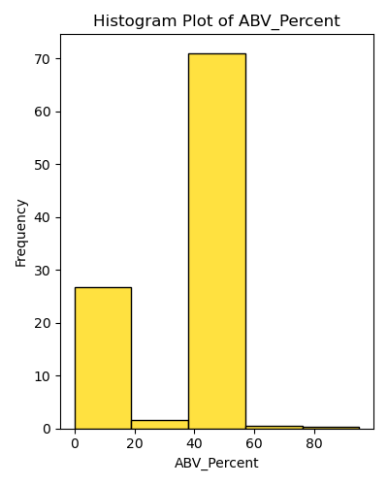
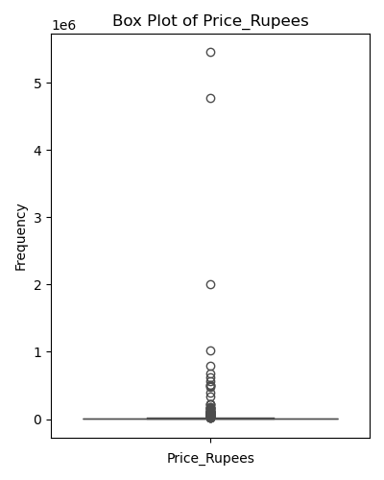
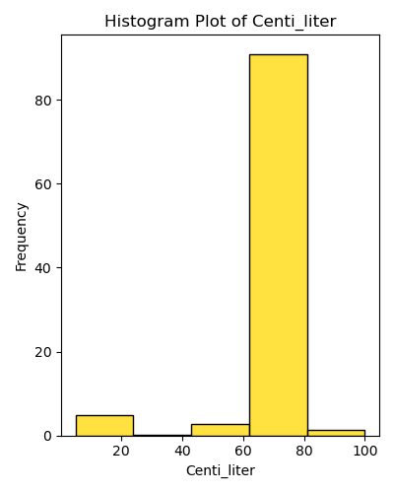
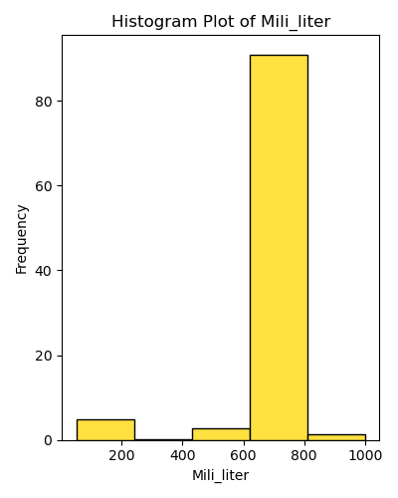
Univariate Graphs On Numerical Columns
Observation : The above plot captures the distribution of data in numerical columns.
Here ABV refers to (Alcohol By Volume)

Slide 9
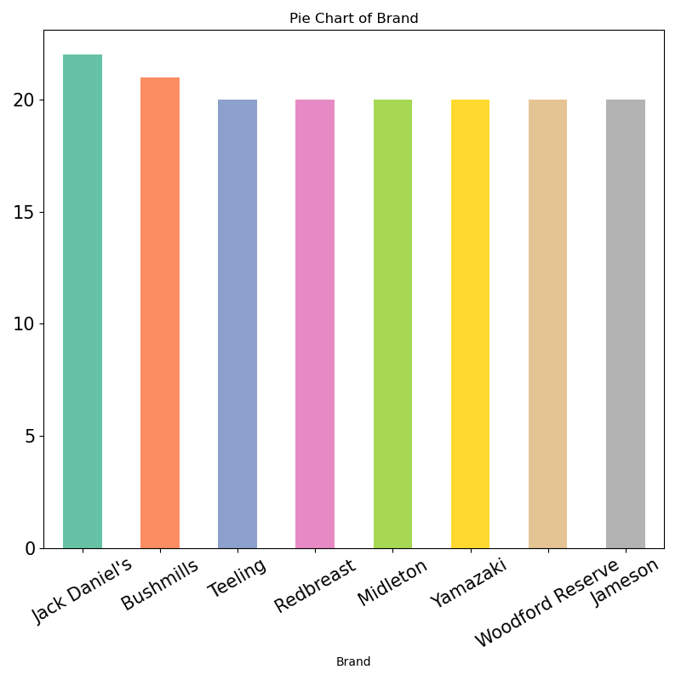
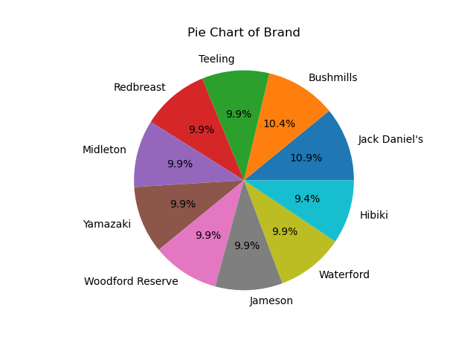
Univariate Graphs On Categorical Columns
Brands
Observation : Jack Daniel's holds the highest brand count, representing 10.9% of the total.

Slide 10
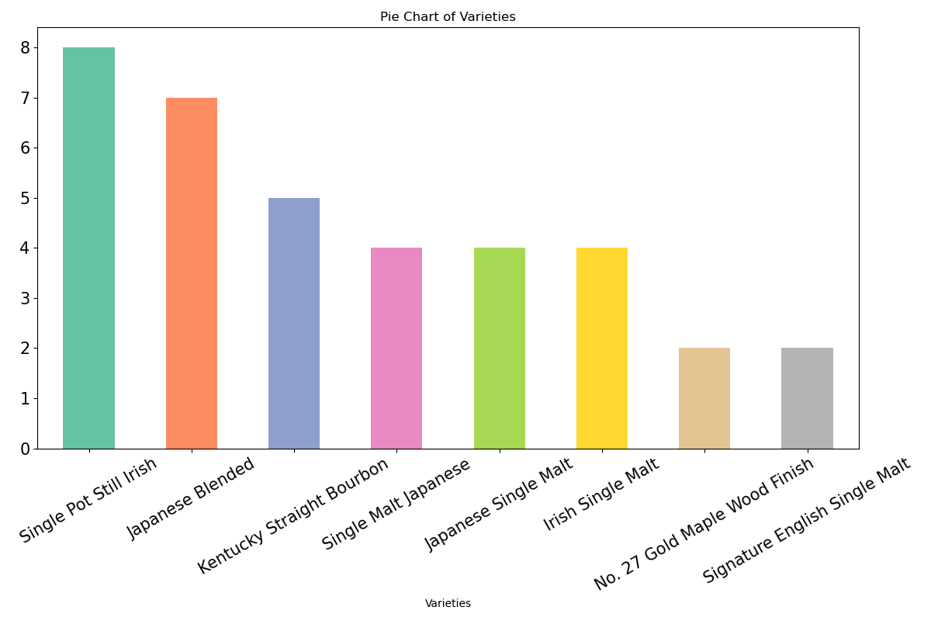
Varieties
Observation : Single Pot Still Irish Whiskey holds the highest share among all varieties at 20%

Slide 11
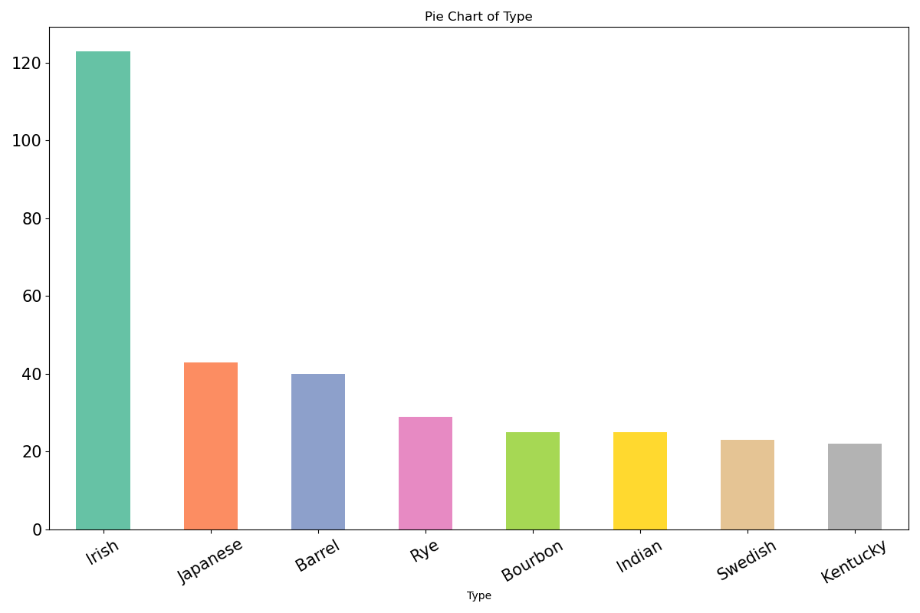
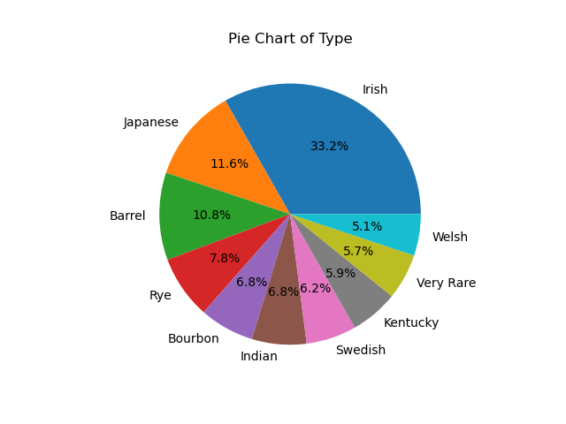
Type
Observation : Irish whiskey ranks as the most dominant type with 33.2 %

Slide 12
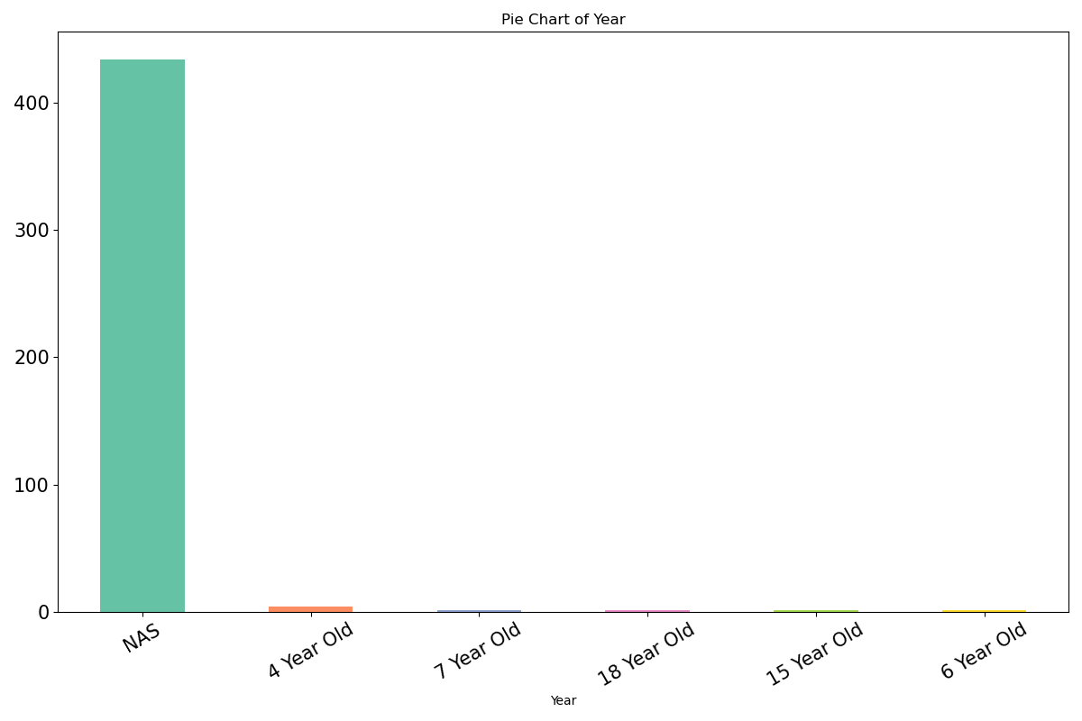
Year
Observation : In the 'Year’ type , NAS holds the highest count with 98.2 %

Slide 13
NAS (NO AGE STATEMENT)
NAS :
It means the whiskey does not display an age on the label (like “12 years” or “18 years”). But that doesn’t mean it’s low-quality — it's just a different approach
Why would a distillery release NAS whiskies? 🧐
Flexibility in blending :
They can use both younger and older barrels to achieve a desired flavor profile.
Supply and demand :
Older whiskey stocks are limited. NAS lets distilleries keep up with demand without waiting years for aging.
Focus on taste, not age :
Some whiskies taste amazing even at a young age. NAS bottles invite drinkers to judge by flavor, not number.

Slide 14
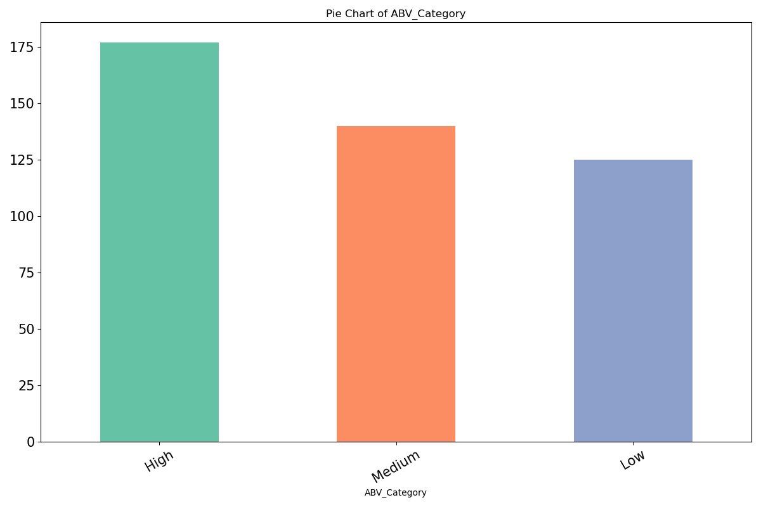
ABV Category
LOW : ABV% < 40%
MEDIUM : ABV% between 40% - 47%
HARD : ABV% > 47%
Observation : ABV Category with High% has the highest count

Slide 15
Is it true that higher-priced whiskies also have a higher ABV percentage?🧐

Slide 16
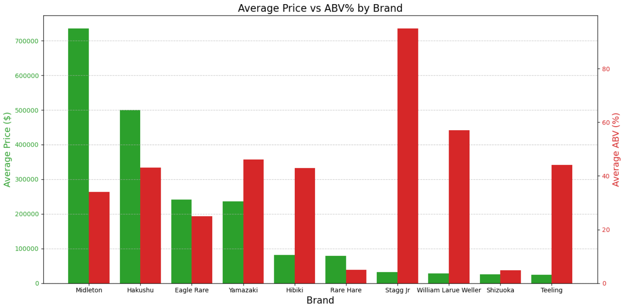
Grouped Bar Chart of Avg Price vs ABV Percentage by Brand
Observation : Midelton has the highest price where Stagg jr has the highest alcoholic count.

Slide 17
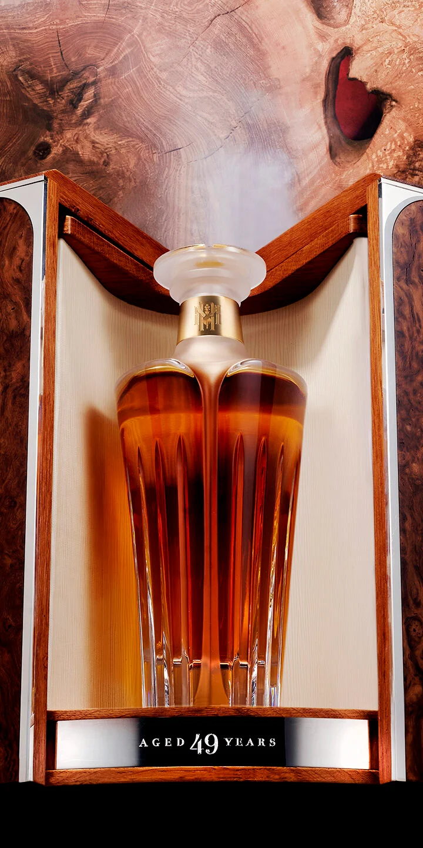
Midleton Very Rare Silent Distillery Chapter 5
Cost : 54,52,794 rs

Slide 18
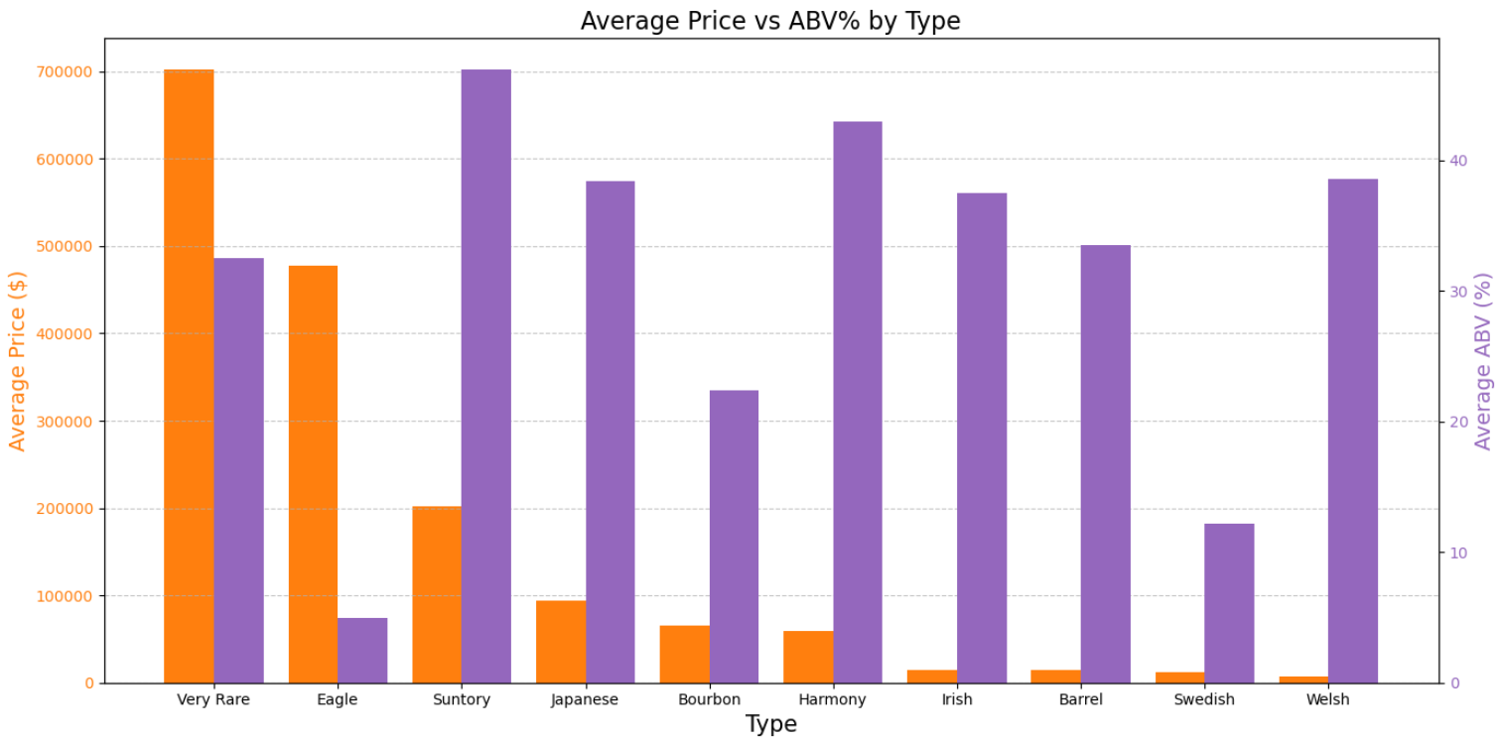
Grouped Bar Plot of Avg Price vs ABV Percentage by Type
Observation : Very Rare type has highest price whereas Suntory has highest ABV count

Slide 19
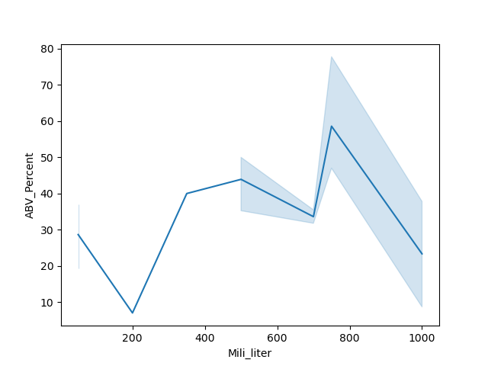
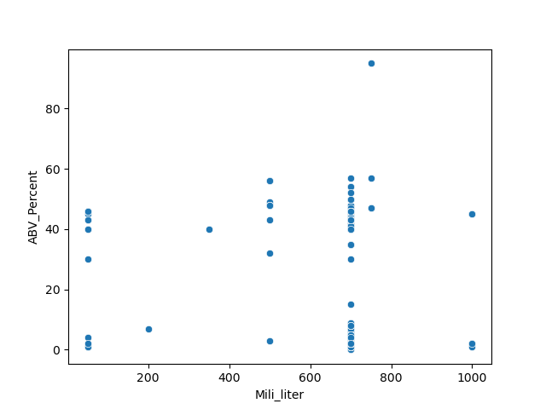
ABV Percent vs Mililiter (Num vs Num)
Observation : Mililiter between 600 to 800 have higher ABV_Percent

Slide 20
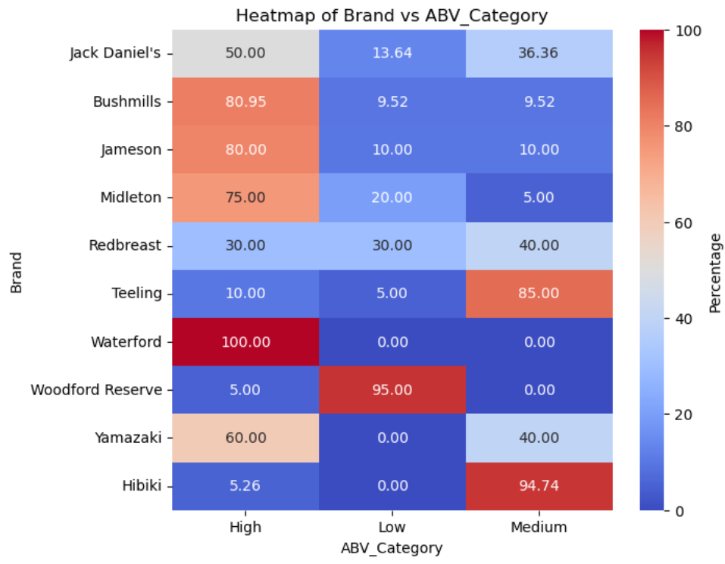
Heat Map on Brand vs ABV Category
Obervation :
Waterford → High
WoodFord Reserve → Low
Hibiki → Medium

Slide 21
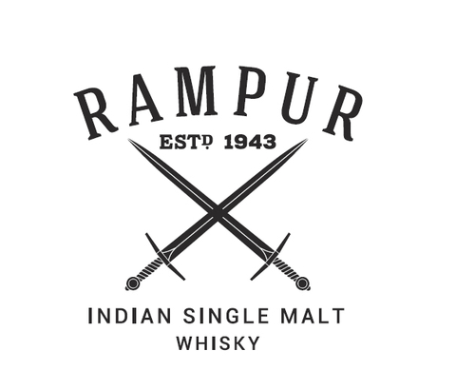

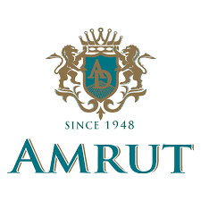
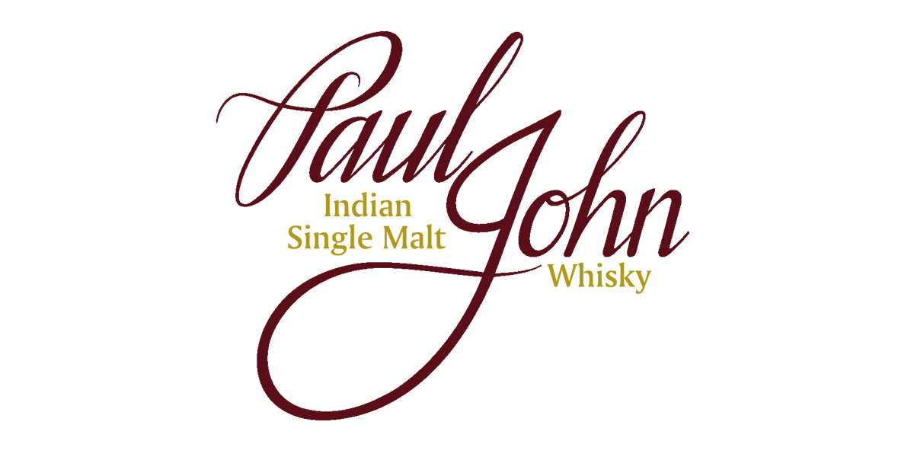
Some Indian Brands

Slide 22
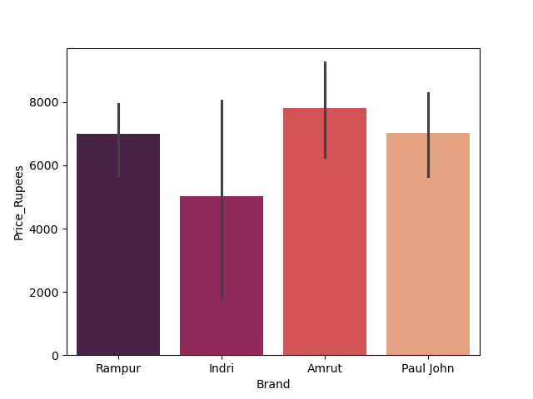
Indian Brands : Brand vs Price
Observation : Amrut has the highest price among all Indian Brands

Slide 23
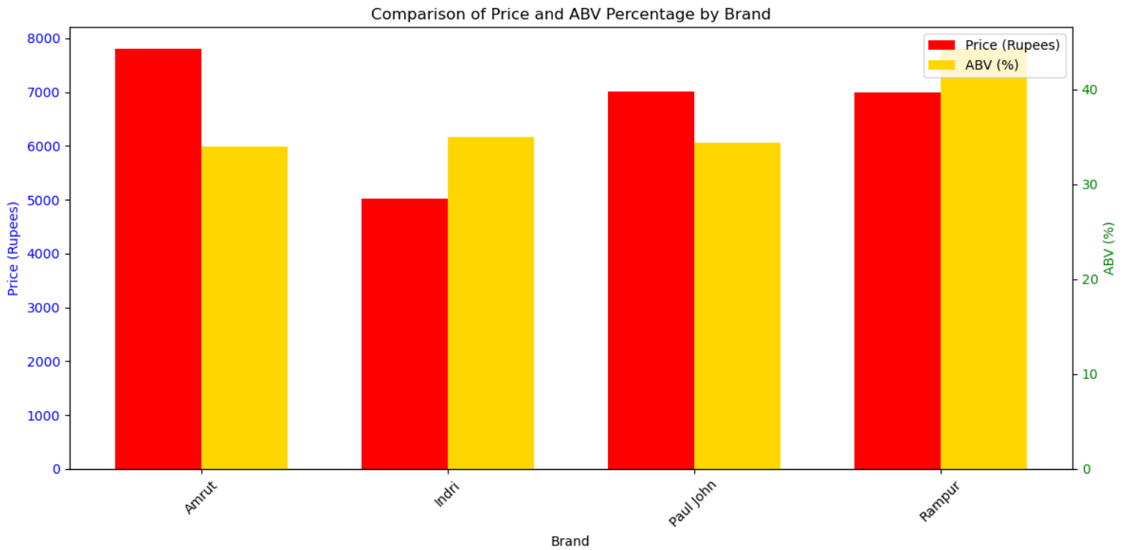
Group Bar Plot of Price and ABV Percentage by Indian Brands
Observation : Amrut has the highest price where Rampur has the highest ABV Percentage

Slide 24
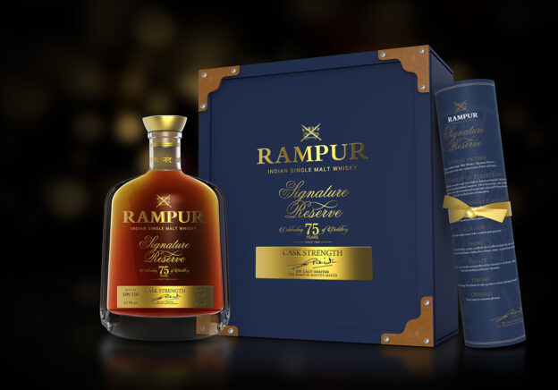
After Some Research I found
The Rampur Signature Reserve Single Malt Whisky.
Cost : 5,00,000 rs .
Currently there are 400 Bottles in the world.

Slide 25
Conclusion
In this messy whiskey market data Which reveals key trends in Brands , Price , ABV Percentage , etc .
Which empowers smarter investment and sales decision through insights.
Future Enhancement For Growth Opportunities:
Collect Data From Multiple Sources (Auctions , Retail Shops , etc)
Analyse social media , blogs and reviews to track consumer sentiment towards towards different whiskey brands and varieties .
We can build a dashboard using Power Bi or Tableau for users to explore whiskeys
We can use selenium for better data extraction .
Consumer psychology plays a significant role in the whiskey market, influencing purchasing decisions through factors like brand loyalty, price perception, and emotional connections with brands and their stories.

Slide 26
Questions ❓

Slide 27

THANK YOU

